Slide 1
PROTEIN CHEMISTRY
By
Mrs. Aparna Patil Kose
Lecturer
Dept of Bioinformatics

Slide 2
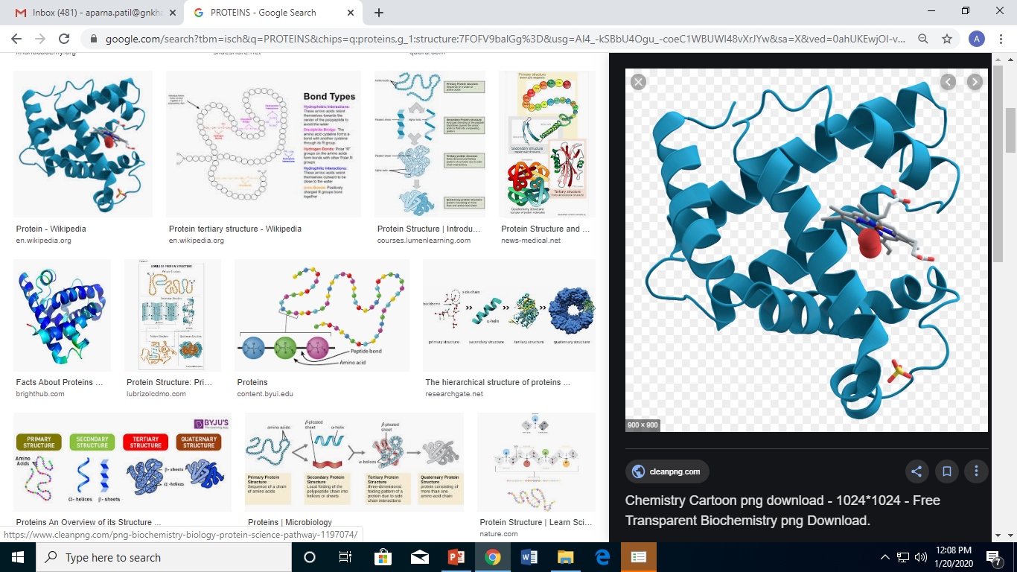
PROTEINS
Proteins (organic compounds ) which are present in the
body and vital to every living cell.
In the form of enzymes, hormones, antibodies, and globulins,
they catalyze, regulate, and protect the body chemistry.
In form of haemoglobin, myoglobin and
various lipoproteins, they work for transport of oxygen and
other substances within an organism.
Proteins are generally regarded as beneficial,
and are a necessary part of the diet of all animals.
Humans can become seriously ill if they
do not eat enough suitable protein, the
disease kwashiorkor being an extreme form of protein deficiency.

Slide 3
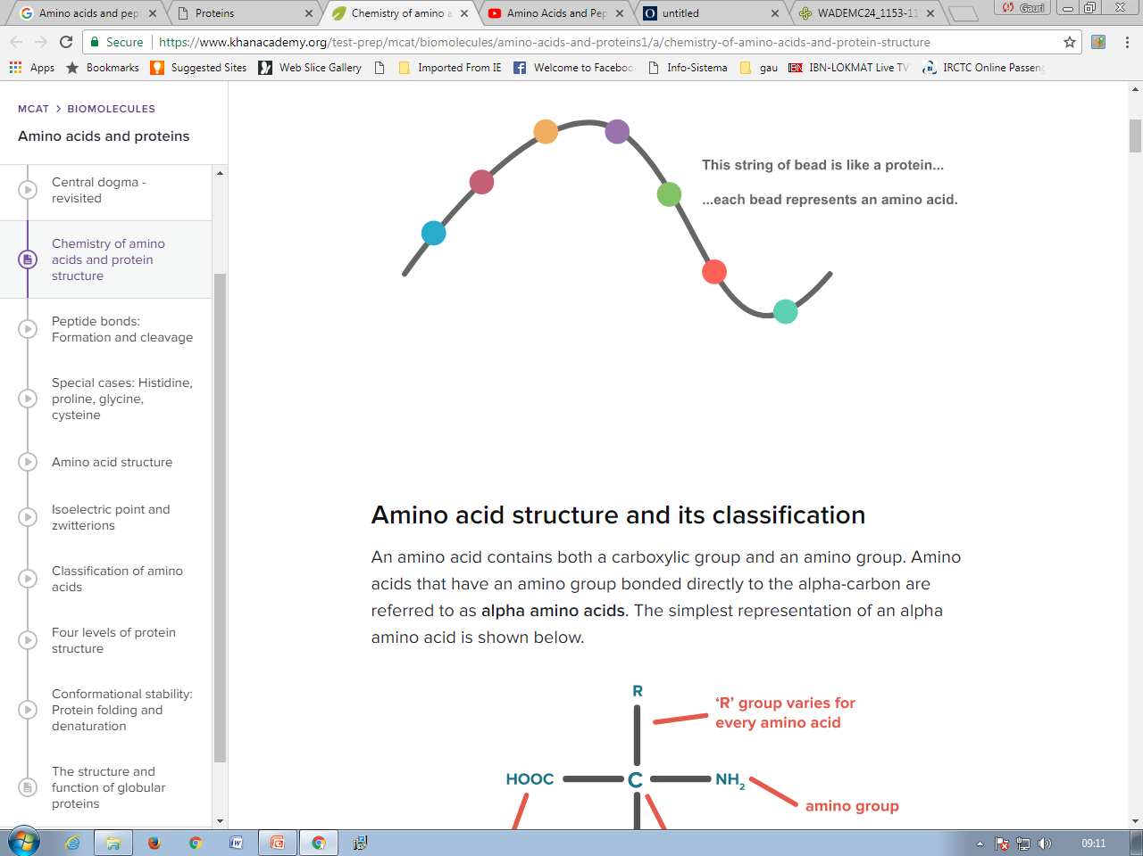
Amino Acid And Peptides
Proteins are large, complex molecules.
Important for normal functioning of the human body.
Proteins are made up of hundreds of smaller units called amino acids that are attached to one another by peptide bonds, forming a long chain.

Slide 4
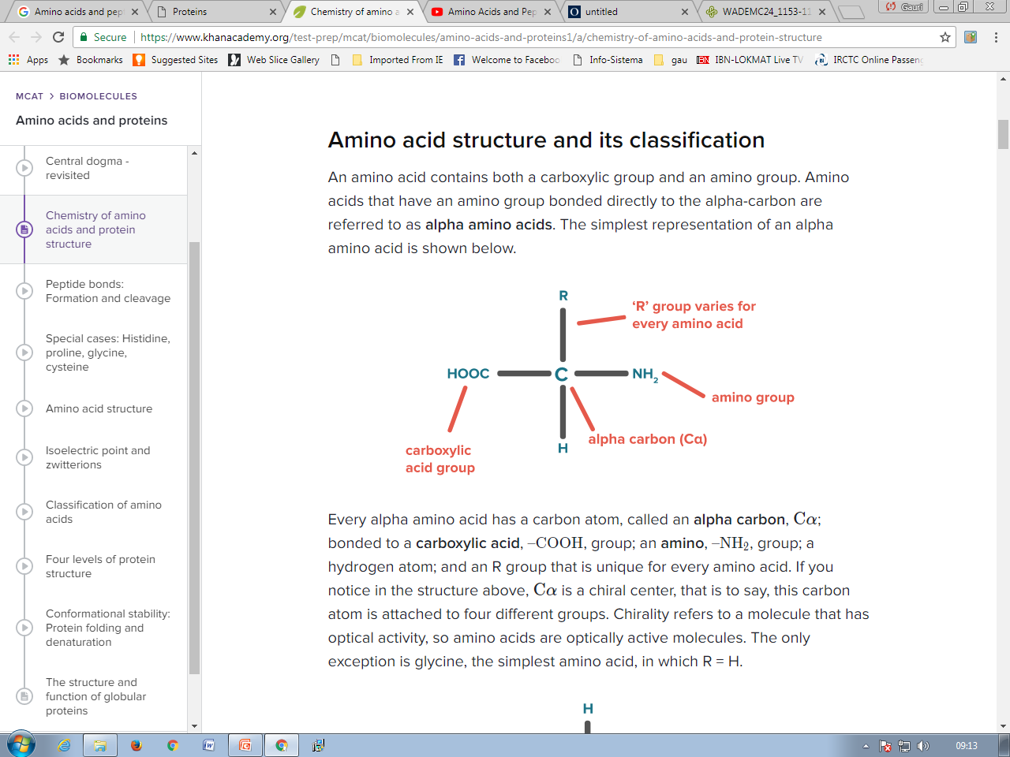
Amino acid structure and its classification
An amino acid contains both a carboxylic group and an amino group.
Amino acids that have an amino group bonded directly to the alpha-carbon are referred to as alpha amino acids.
Cα is a chiral .

Slide 5
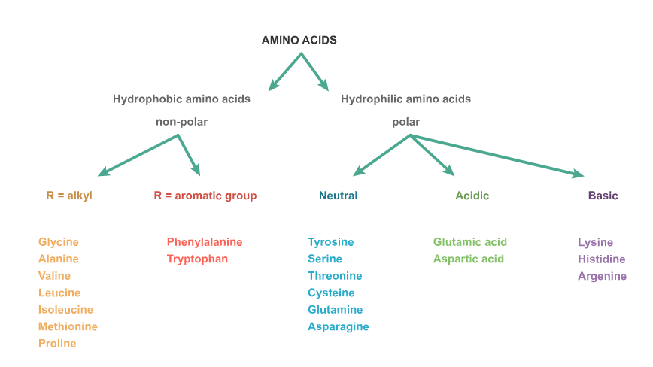
There are 20 common amino acids. Based on the nature of the R group, they are classified as follows:

Slide 6
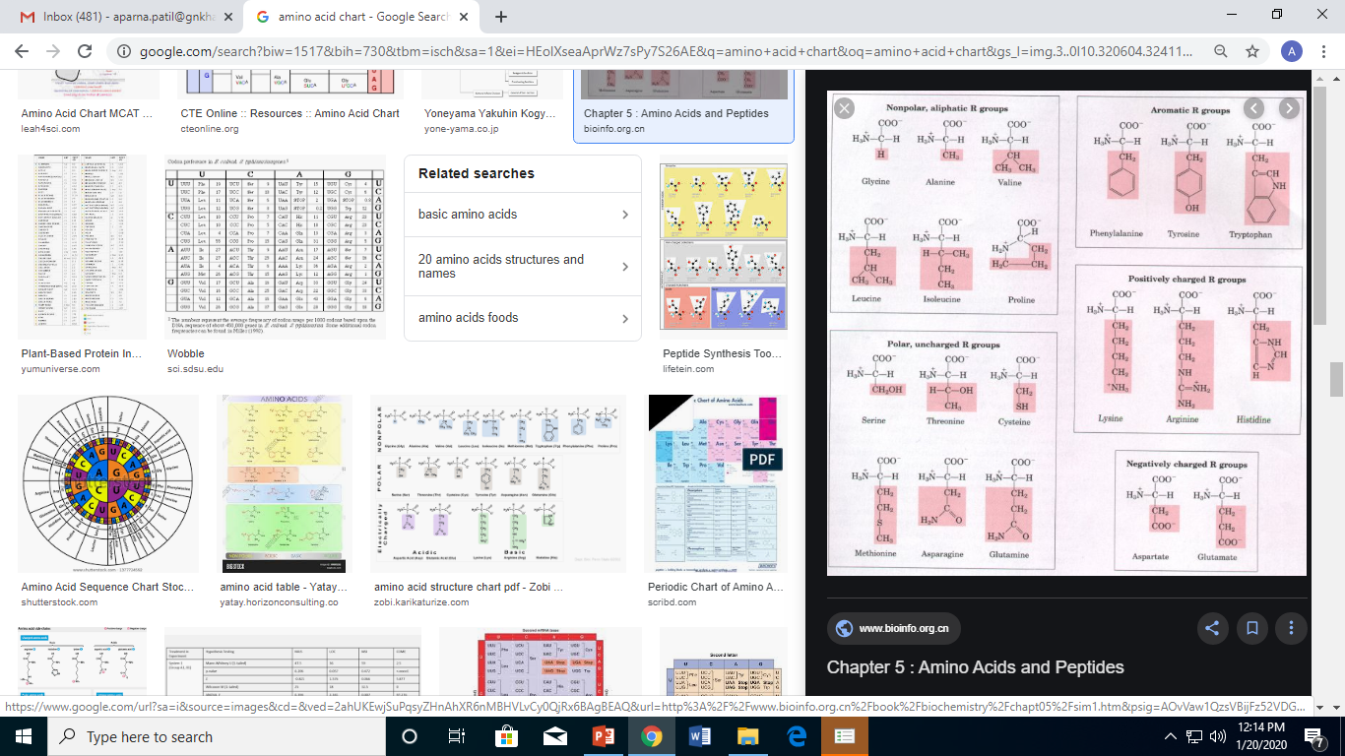

Slide 7
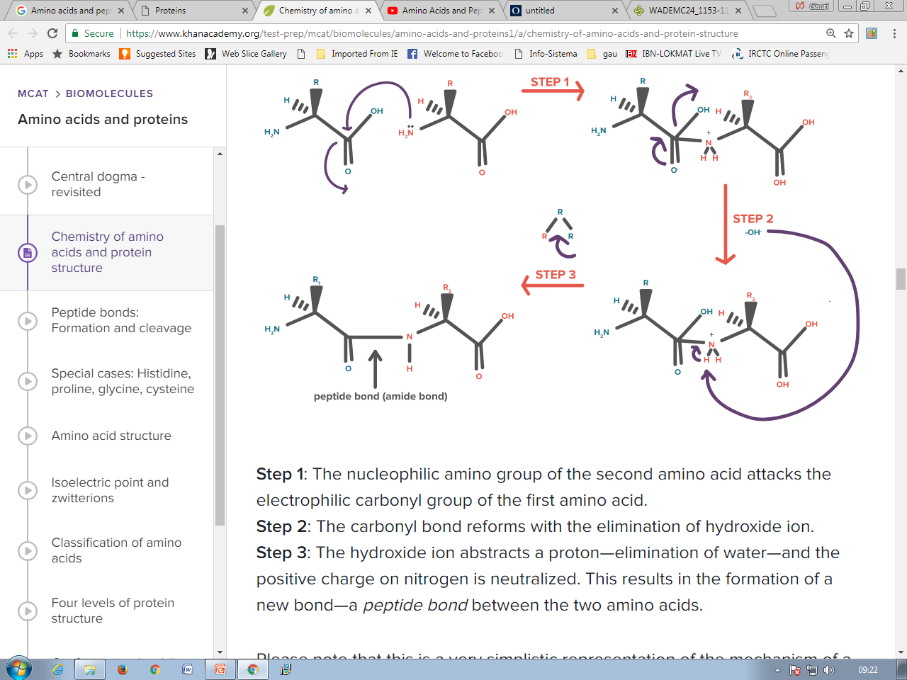
Amino acids are joined together through peptide bonds.
Peptide bonds are covalent bonds formed by the nucleophilic addition-elimination reaction between the carboxylic group of one amino acid and the amino group of another amino acid; this reaction releases a molecule of water as the by product.
A peptide bond is essentially an amide bond.

Slide 8
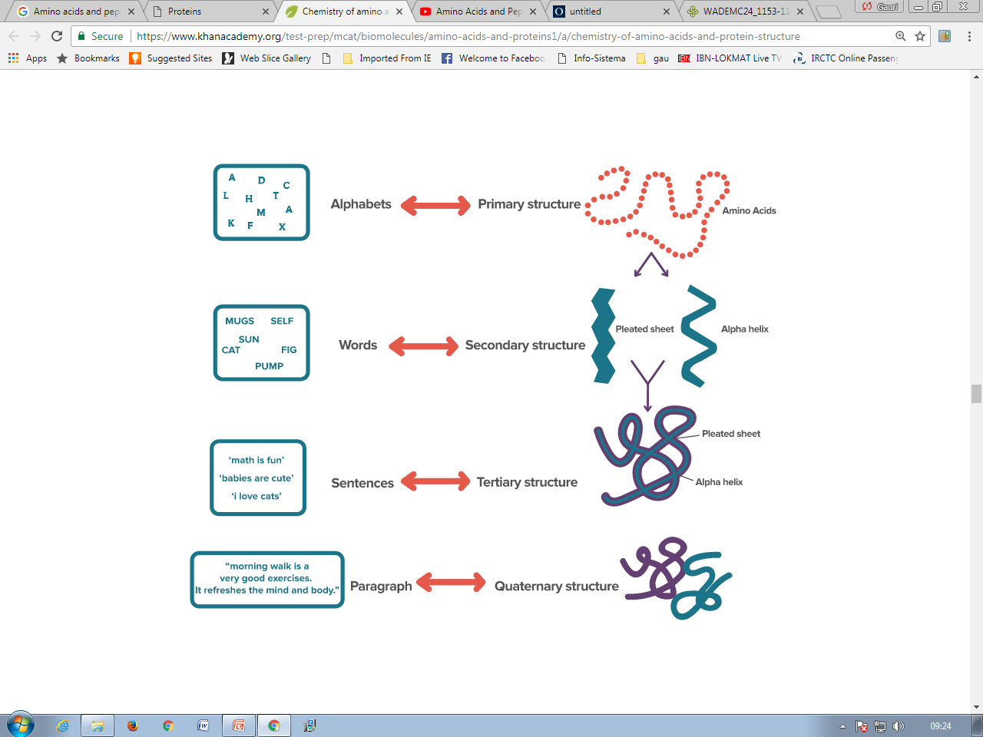
Different levels of protein structure
The four levels of protein structure are: primary structure, secondary structure, super secondary structure, tertiary structure, and quaternary structure.

Slide 9
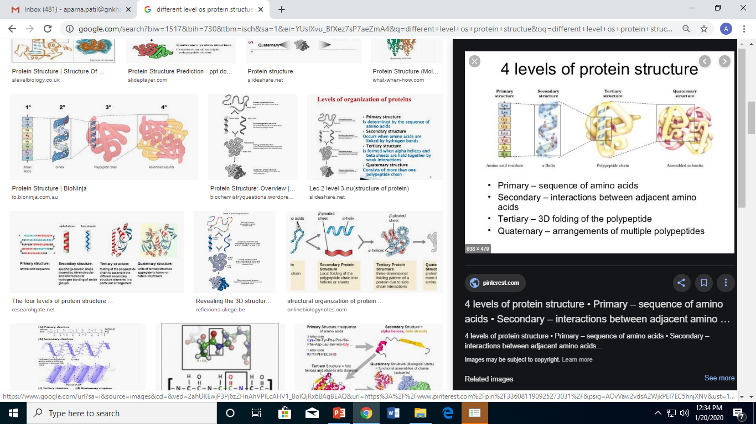

Slide 10
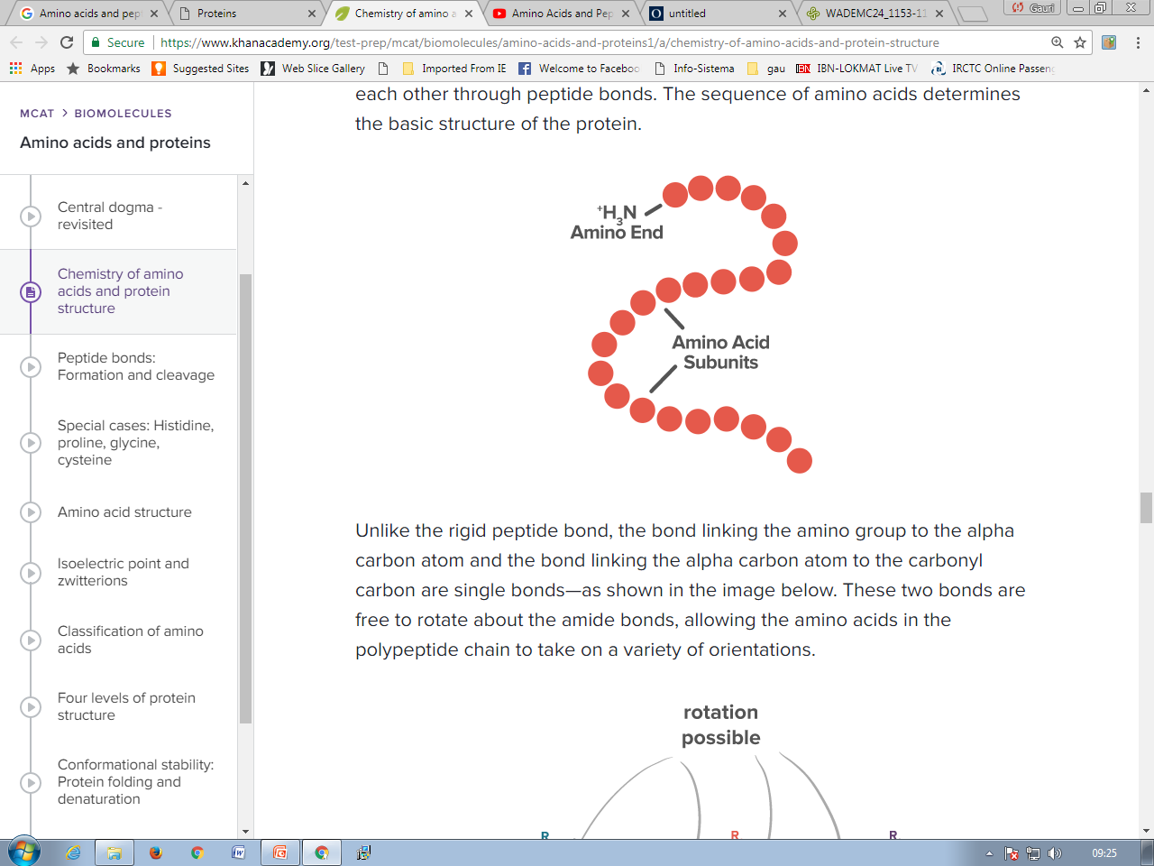
Primary structure
Primary structure simply refers to the linear sequence of amino acids joined to each other through peptide bonds.
The sequence of amino acids determines the basic structure of the protein.
The bond linking the amino group to the alpha carbon atom and the bond linking the alpha carbon atom to the carbonyl carbon are single bonds making it flexible to fold.

Slide 11
Secondary structure
The folded structures are referred to as secondary protein structures and are essentially of two types—
alpha helix and
beta pleated sheets.
These folded secondary structures are stabilized by the formation of hydrogen bonds between the amino acids.

Slide 12
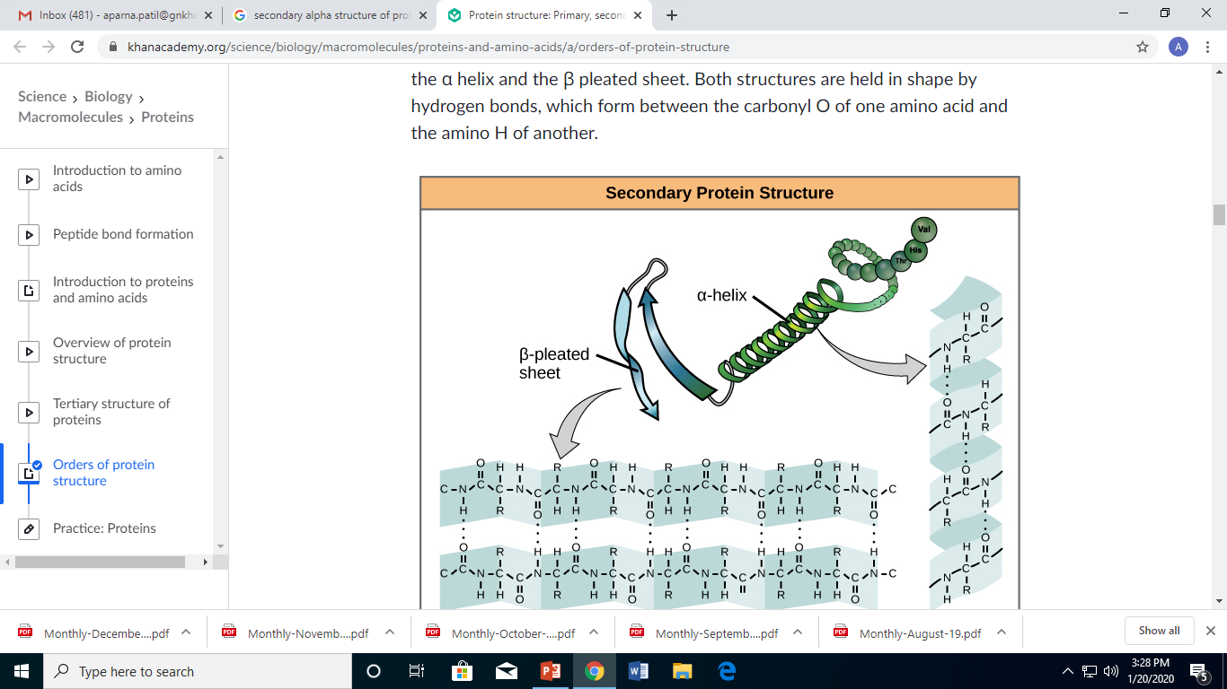
α-helix
In an α helix, the amino acids get oriented in such a manner that the carbonyl, C=O, group of the nth amino acid can form a hydrogen bond with the amido, N-H, group of the (n+4)​th ​​amino acid i.e. (E.g., the carbonyl of amino acid 1 would form a hydrogen bond to the N-H of amino acid 5) and results in strong hydrogen bond.
This pattern of bonding pulls the polypeptide chain into a helical structure that resembles a curled ribbon, with each turn of the helix.
The R groups of the amino acids stick outward from the α helix, where they are free to interact.

Slide 13
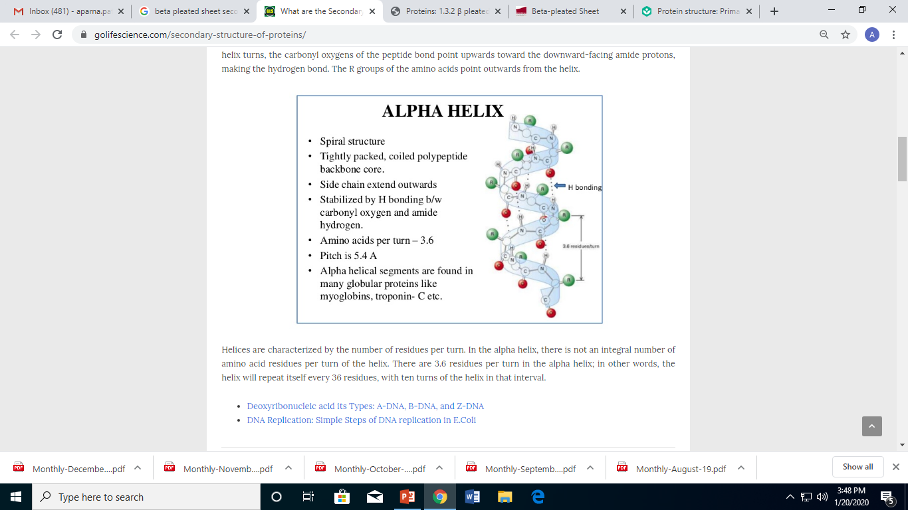

Slide 14
β-pleated sheet
In β sheets, however, hydrogen bonding occurs between neighbouring polypeptide chains rather than within the same polypeptide
Sheets exist in two forms:
1. Antiparallel β sheet: Has neighboring hydrogen-bonded polypeptide chains running in opposite directions.
i.e., one polypeptide chain starts from the terminal carboxylic group and ends at the terminal amino group, while the other polypeptide chain starts from the terminal amino group and ends at the terminal carboxylic group.
2. Parallel β sheet: Has hydrogen-bonded chains extending in the same direction.

Slide 15
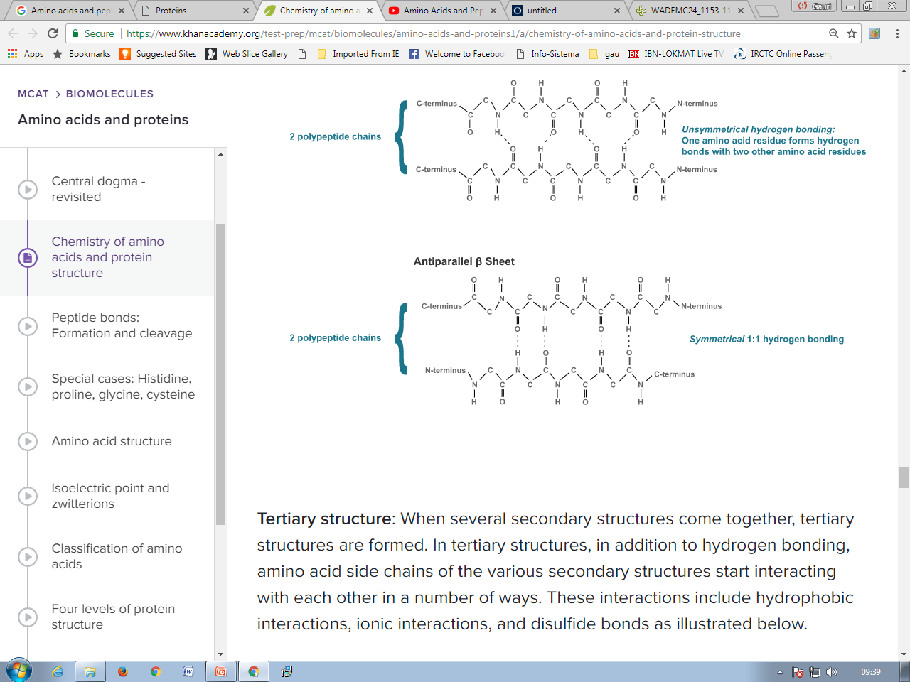

Slide 16
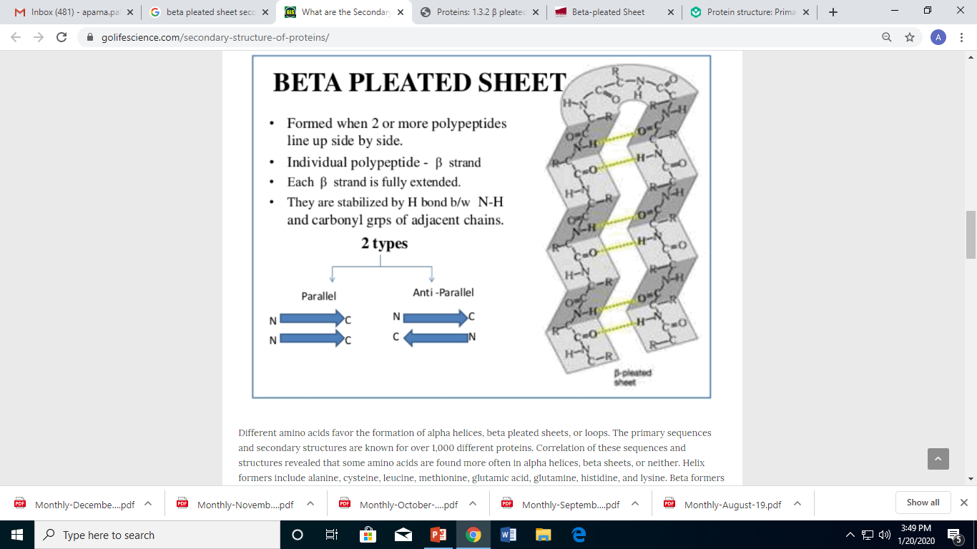

Slide 17
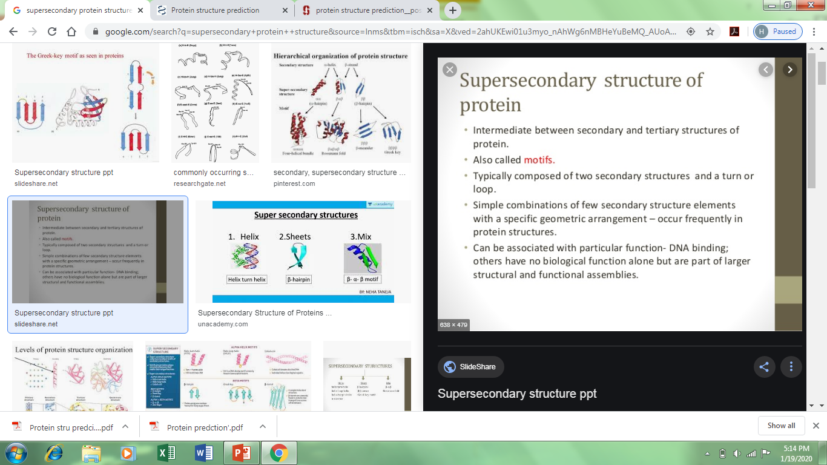

Slide 18
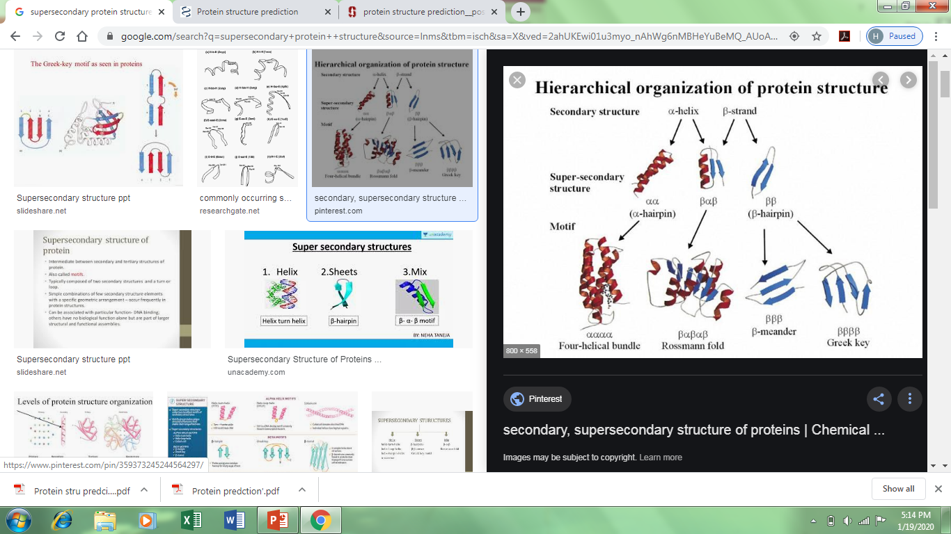

Slide 19
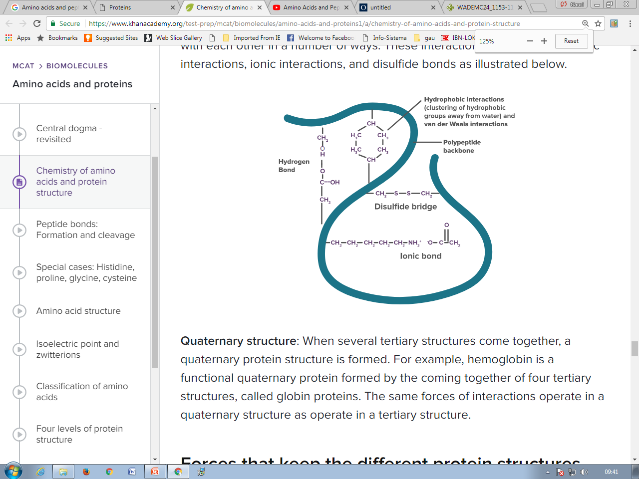
Tertiary structure
When several secondary structures come together, tertiary structures are formed.
In tertiary structures, in addition to hydrogen bonding, amino acid side chains of the various secondary structures start interacting with each other in a number of ways.
The tertiary structure is where the protein begins to take on its final three-dimensional shape via polypeptide side chain interactions, as opposed to primary and secondary structure wherein the amino and carboxy groups create the bonds.
These interactions include hydrophobic interactions, ionic interactions, and disulfide bonds.

Slide 20
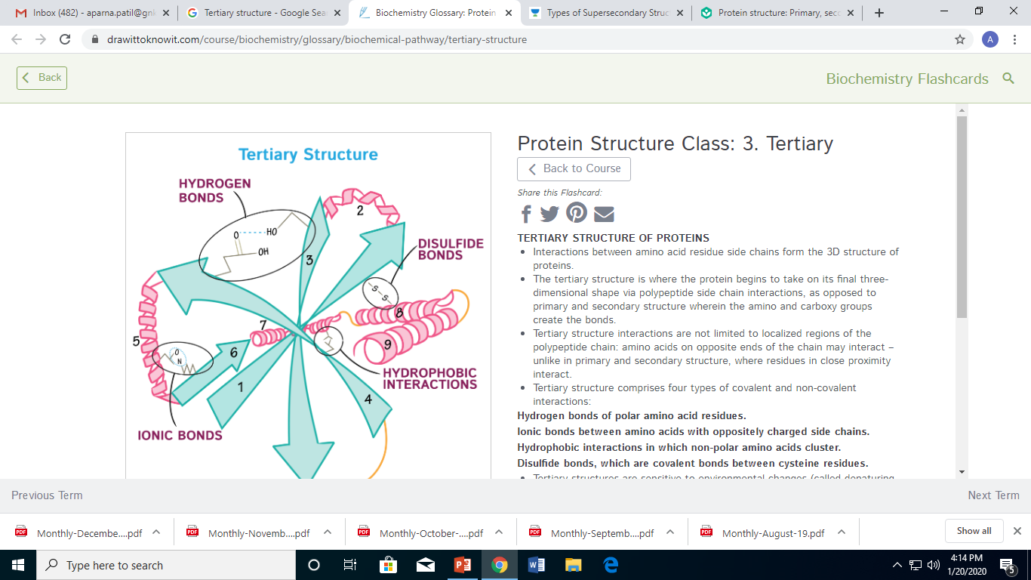

Slide 21
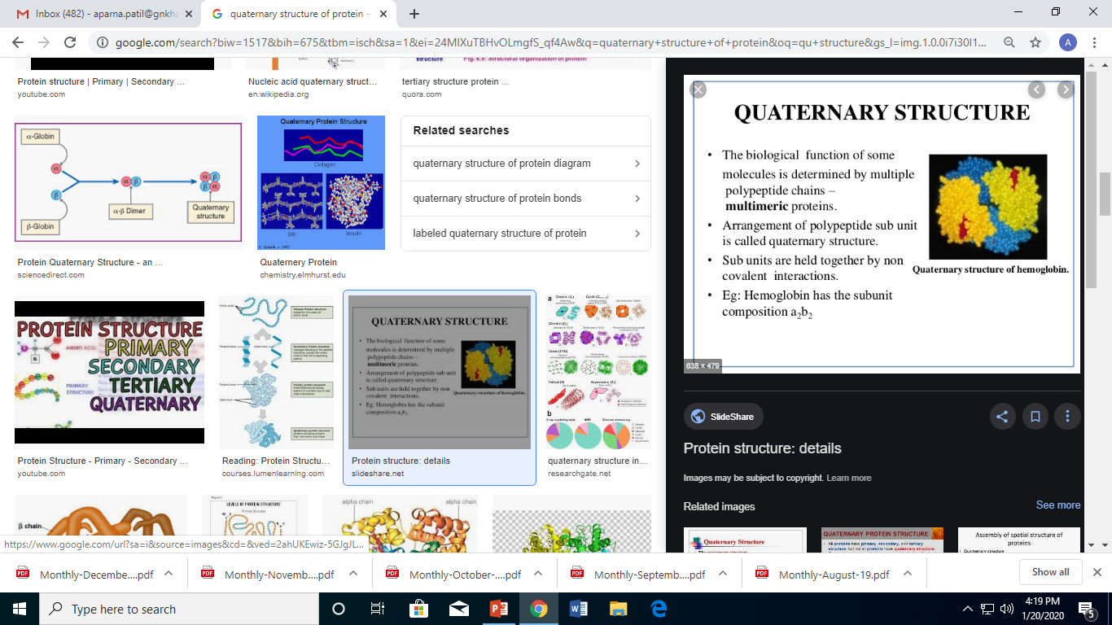

Slide 22
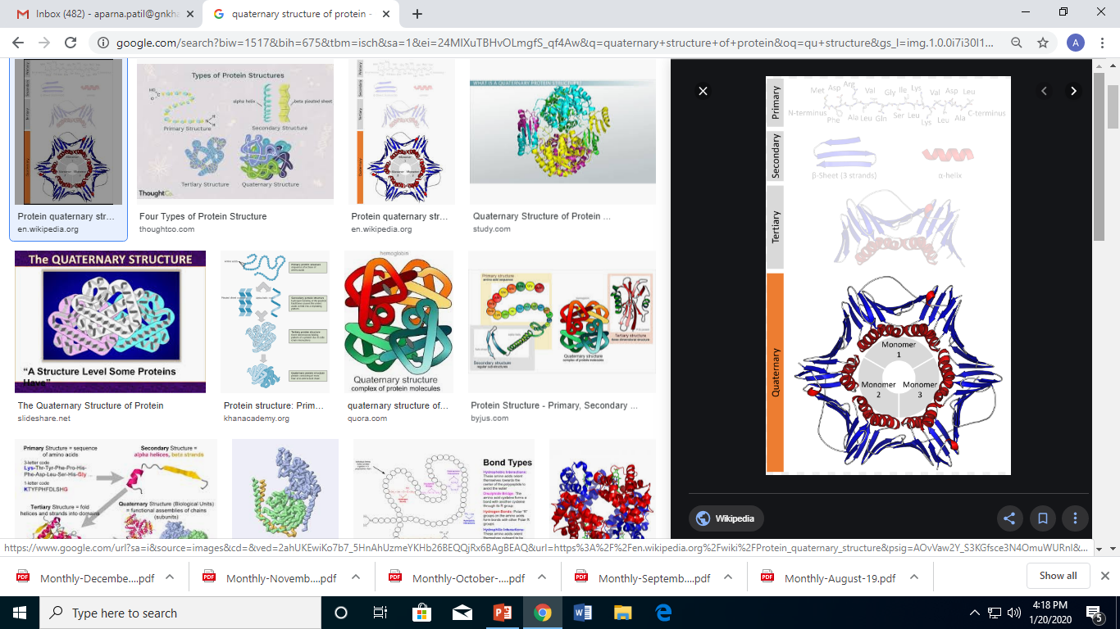

Slide 23
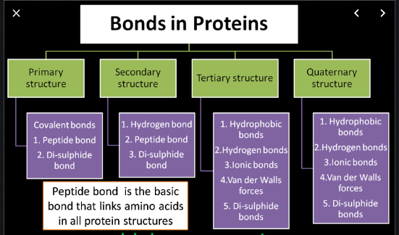

Slide 24
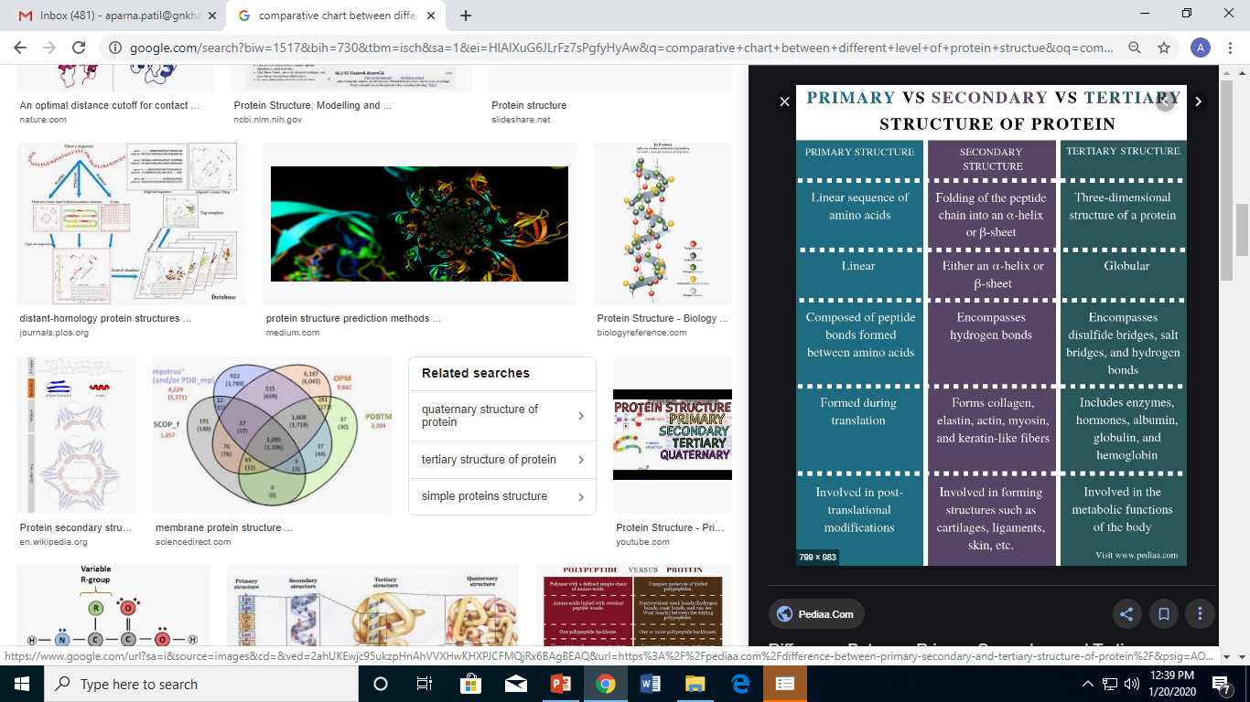

Slide 25
VARIOUS INTERACTIONS

Slide 26
ASSIGNMENT
Hydrophobic Interactions
Hydrogen bonds
Ionic Interaction
Vander der interaction
Di-sulphide bonds
How Thermodynamics plays a role in molecular interaction. Comment on the below given terms and their role in interaction studies along with their inter-relationship with each other.
Entropy
Enthalpy
Gibbs free energy

Slide 27
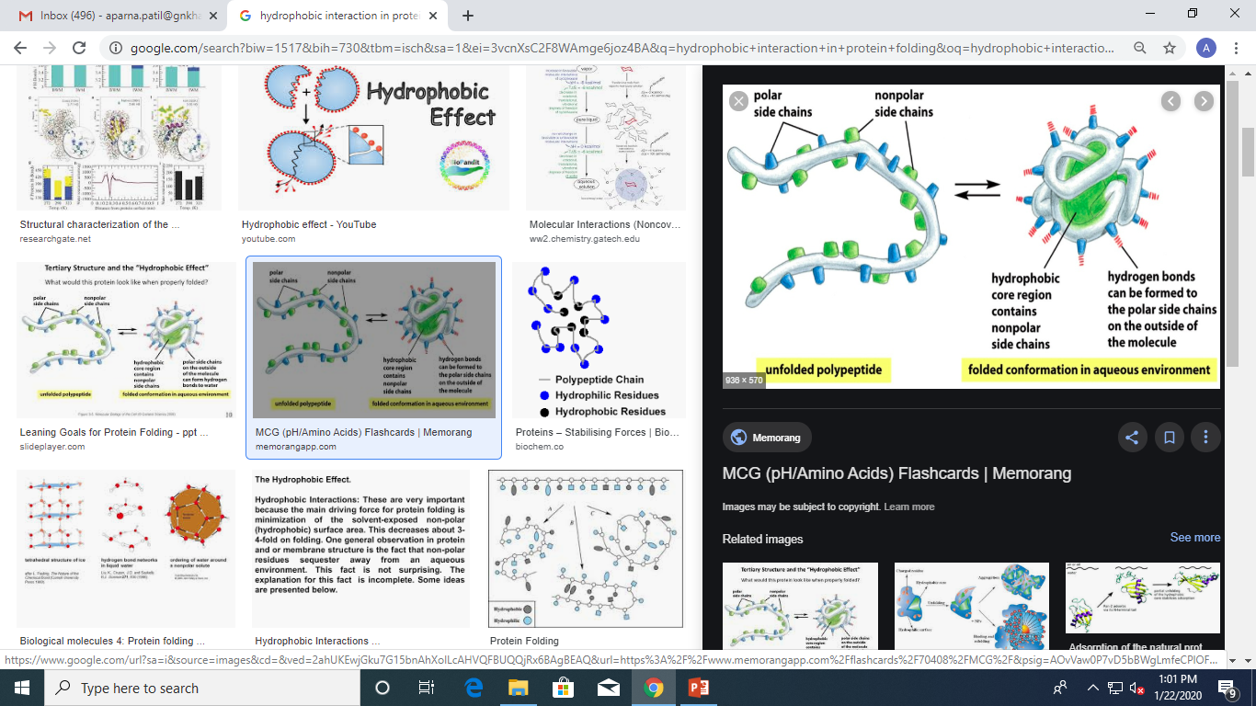

Slide 28
Protein folding- Molecular chaperones

Slide 29
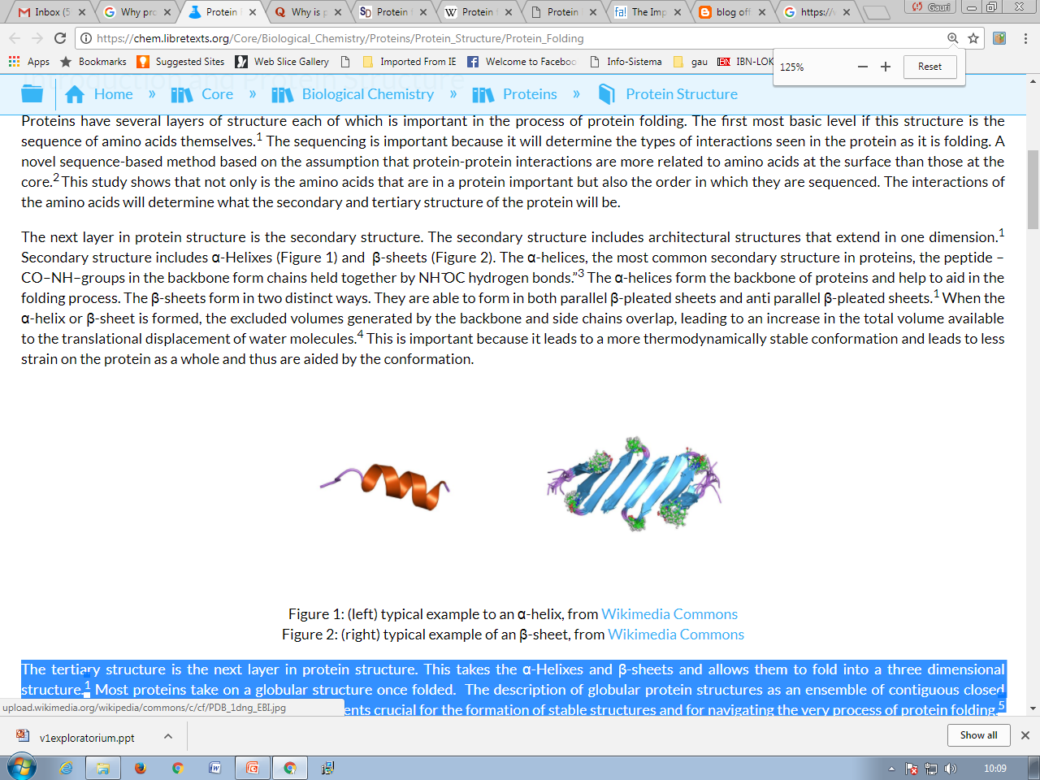
INTRODUCTION
Proteins have several layers of structure each of which is important in the process of protein folding.
Sequence of amino acids :
a. it will determine the types of interactions seen in the protein as it
is folding.
b. protein-protein interactions are more related to amino acids at
the surface than those at the core.(novel sequence-based method
assumptions)
c. the order in which they(Sequences) are sequenced is also
important
The interactions of the amino acids will determine what the secondary and tertiary structure of the protein will be.

Slide 30
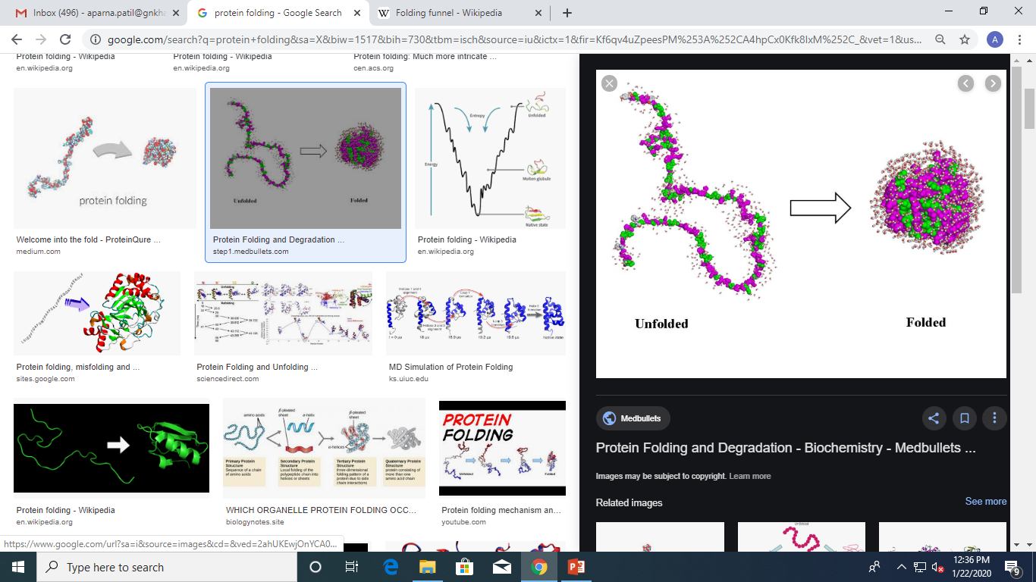
CONT’D
Protein folding is the physical process by which a protein chain acquires its native 3-dimensional structure.
A conformation that is usually biologically functional, in an expeditious and reproducible manner.
Protein folding will determine the- FUNCTION
Most of the proteins fold on their own and it’s a spontaneous process.

Slide 31
WHY
AND
HOW
What factors determine protein folding?
Intrinsic factors:→ Amino acid sequence
→Hydrophobic interactions
→Intramolecular H bonds
→Disulfide linkages
Extrinsic factors: →Temperature
→Electric/Magnetic field
→Presence of water
→Macromolecular crowding

Slide 32
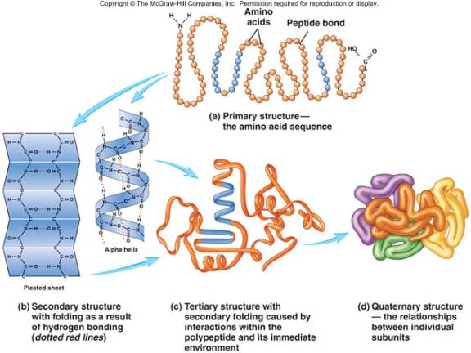

Slide 33
Levinthal Paradox
There are too many different possible conformations for a protein to fold by a random search.
For eg. 101 a.a long protein→100 peptide bonds
each peptide bond→3 different stable conformations
Hence 3¹ºº possible conformations
10¹³conformations/sec→ it will take 10²²years
1969,Cyrus Levinthal suggested that proteins fold through well-defined pathways, and not by sampling the different possible conformations.

Slide 34
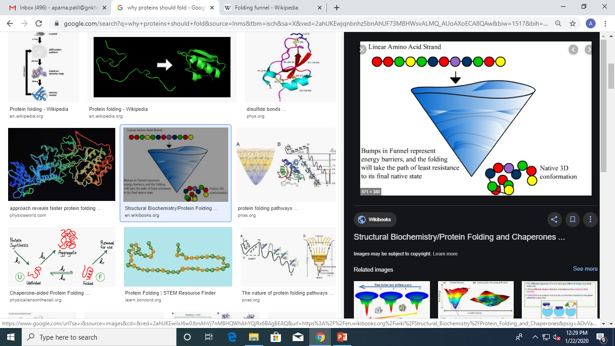
Thermodynamics of protein folding

Slide 35
Why does protein folding sometimes fail?
1. A person might possess a mutation that changes an amino acid in the protein chain, making it difficult for a particular protein to find its preferred fold or “native” state. EG: cystic fibrosis or sickle cell anemia.
2. When proteins are created, the machine that reads the directions from DNA to create the long chains of amino acids can make mistakes. Scientists estimate that this machine, the ribosome, makes mistakes in as many as 1 in every 7 proteins!
3. Even if an amino acid chain has no mutations or mistakes, it may still not reach its preferred folded shape simply because proteins do not fold correctly 100% of the time.

Slide 36
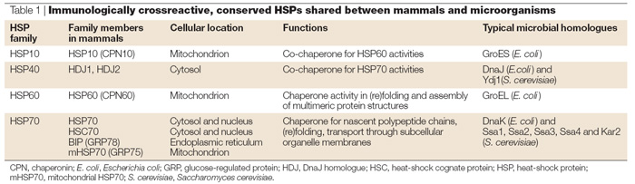
Molecular Chaperones
Proteins that assist the covalent folding or unfolding and the assembly or disassembly of other macromolecular structures.
Function: to prevent both newly synthesized polypeptide chains and assembled subunits from aggregating into non-functional structures.

Slide 37
Prokaryotic GroEL /ES system
Present in Escherichia coli.
Chaperonins : large cylindrical protein complexes that assist the folding of a newly-synthesized protein in an ATP-dependent manner.
GroEL is a member of Hsp 60 protein family & GroES, a member of Hsp10 family acts like a lid to it.
GroEL complex consists of two large pockets formed by 2 heptameric rings each subunit of mol.wt.57 KDa.
GroES, also a heptamer (subunits of mol.wt.10 KDa) blocks one of the GroEL pockets.

Slide 38
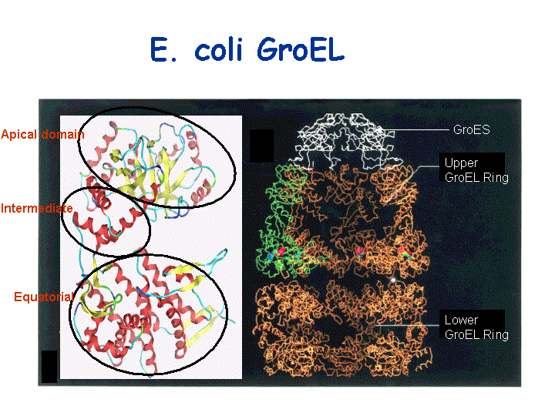

Slide 39
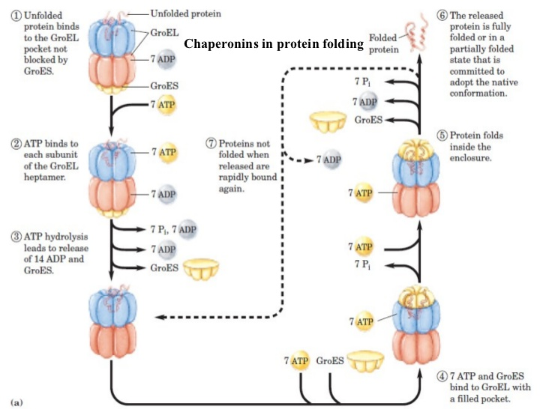

Slide 40
Eukaryotic Molecular Chaperones
Heat shock proteins (Hsp) system
Hsp70: Mol.wt.70KDa,abundant under stressful conditions(heat)
Functions: Binds to unfolded polypeptide rich in hydrophobic residues.
Blocks folding of certain proteins.
Hsp40: Mol.wt.40KDa,contains a J domain
Function: Stimulates ATPase activity of Hsp70 & facilitates protein folding
Homologus to Dna K & Dna J system in E.coli

Slide 41
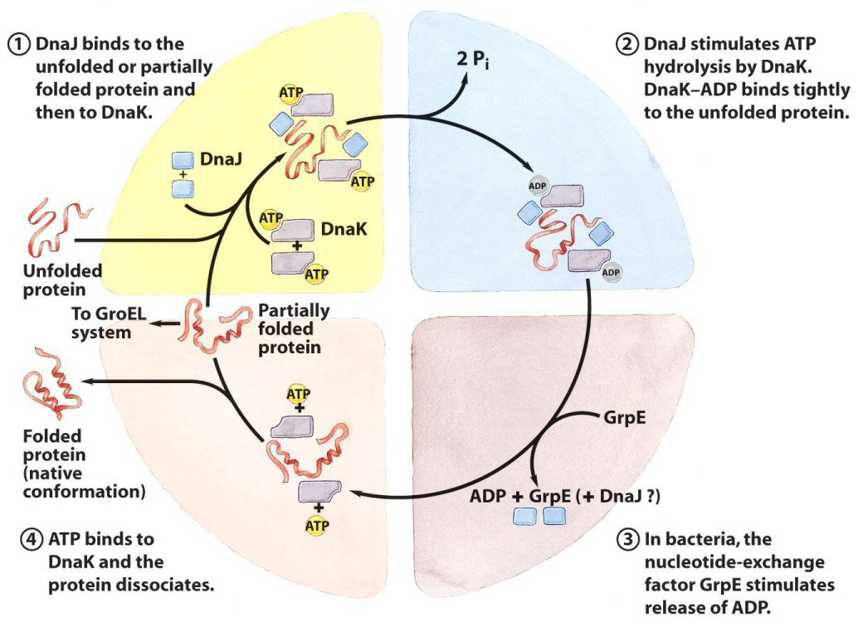

Slide 42
Protein Disulfide Isomerase (PDI)
Protein disulfide isomerase or PDI is an enzyme.
Found : Endoplasmic reticulum in eukaryotes
Function: Catalyzes the formation and breakage of disulfide bonds between cysteine residues within proteins as they fold.
This allows proteins to quickly find the correct arrangement of disulfide bonds in their fully folded state, and therefore the enzyme acts to catalyze protein folding.
Write a snort not on: Mechanism of PDI enzyme

Slide 43
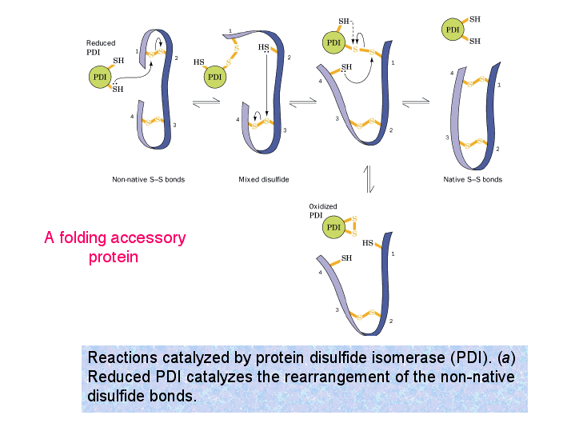
Enzymes that catalyze protein folding
Protein Disulfide Isomerase (PDI)

Slide 44
Peptidyl Prolyl cis-trans Isomerase(PPI)
Prolyl isomerase (also known as peptidylprolyl isomerase or PPIase) is an enzyme.
Found : Both prokaryotes and eukaryotes that interconverts the cis and trans isomers of peptide bonds with the amino acid proline.
Why only PROLINE:
Proline has an unusually conformationally restrained peptide bond due to its cyclic structure with its side chain bonded to its secondary amine nitrogen.
Most amino acids have a strong energetic preference for the trans peptide bond conformation due to steric hindrance.
But proline's unusual structure stabilizes the cis form so that both isomers are populated under biologically relevant conditions.

Slide 45
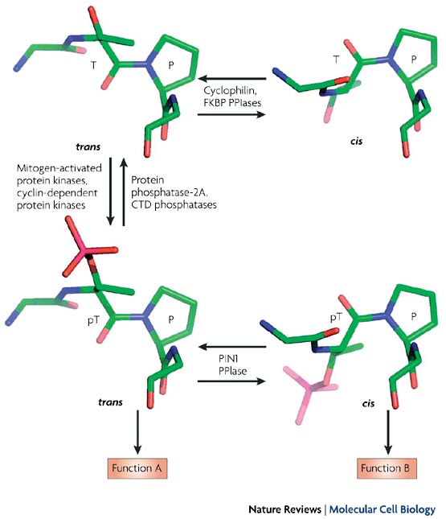
Peptidyl Prolyl cis-trans Isomerase(PPI)

Slide 46
Fate of misfolded proteins
The ER membrane bound chaperone Calnexin binds to misfolded/incompletely folded protein containing a terminal glucose on N-linked oligosaccharides, trapping it in the ER itself.
Misfolded protein in the ER lumen are translocated back into the cytosol, where they are deglycosylated, ubiquitiniylated & degarded in the Proteasomes.
Accumulation of misfolded proteins in the cytosol triggers a heat shock response- upregulation of genes encoding molecular chaperones that help in folding.

Slide 47
The importance of protein folding
Determine functionality of a protein
Protein structure prediction & Protein design
Designing drugs specific to different motifs in a protein
Misfolding of certain proteins leads to neurodegenerative diseases like Alzheimer’s disease & Parkinson’s disease

Slide 48
Chaperon mechanism video
Hsp60:
https://www.youtube.com/watch?v=YQ1A5pP9Z9U
Hsp70 : https://www.youtube.com/watch?v=CtrLhnS70Os

Slide 49
ASSIGNMENT
What are Proteins and explain the role of amino acid in proteins
How Proteins are classified on basis of their R group.
Explain different levels of protein along with an example.
Explain them and give an example for it if any .(Only 1 and 2) (Refer slide No 17 )
Explain the terms (Only 3,4 & 5) give the relationship between them. (Refer slide No 17 )
Write a note on Hsp60 chaperon in detail along with along diagram and mechanism.
Elaborate on the enzymes that catalyzes the protein folding.
Write a note on Hsp70 chaperon in detail along with along diagram and mechanism.
Explain the role of Hydrogen bond and hydrophilic interaction in protein chemistry
Write a note on Anfinsen experiment.
Write short note on :
Allosteric proteins
Misfolding of protein results in various diseases (Any 2 in detail )

Slide 50
References
Alberts -Molecular biology of the cell 5th edition
Lehninger -Principles of Biochemistry 4th edition
Chemistry of amino acids and protein structure: (https://www.khanacademy.org/test-prep/mcat/biomolecules/amino-acids-and-proteins1/a/chemistry-of-amino-acids-and-protein-structure)

